Slide 1
ARPA-E Technology to Market REACT – EV Drivetrain
Helping Clients Succeed
January 2012

Slide 2
ARPA-E is devoted exclusively to transformational energy technology R&D that will bridge the gap from lab to market
Purpose …
Purpose of this ARPA-E Technology to Market Overview
In recent years energy technology advancements have made extraordinary progress in improving performance and reducing costs; however, the sector still struggles with market deployment of breakthrough technology from public investments
ARPA-E believes that to address energy challenges, the agency and recipients require a deeper understanding of the competitive dynamics they will face within their specific markets
This first installment is intended to offer insight into the key players, key relationships and market drivers
We expect future installments to dig deeper, offering information and insights regarding specific segments, customer perspectives, and funding opportunities
The series is intended to serve as a “living document”, which should expand in response to performer suggestions and needs. Please contact Ilan.gur@hq.doe.gov with questions, ideas, etc.

Slide 3
REACT - EV Drivetrain Non-Superconducting
Round 4 FOAs
Round 4 FOA Markets
ARPA-E Selected Analysis
Value Chain | Relationship Analysis | Competitive Analysis | Market Requirement
 |  | Tech
Solar ADEPT
Solar Power Electronics
GENI
Power Control Software
High Voltage Hardware
Thermal Solar & Nuclear Power
HEATS
Electric Vehicle HVAC
Thermal Fuel
Permanent Magnet Material
REACT
EV Drivetrain Non-Superconducting
Wind Turbine Generator
PETRO
Fuel/ Biofuel

Slide 4
Motors comprise the heart of the EV value chain
Batteries are a critical drive train element, but are not a focus of this study
Magnets
Motor
Transmission
Power
Electronics
Vehicle
assembly
Finished vehicle
Activity | Manufacturing | Manufacturing | Manufacturing | Manufacturing | Assembly | Final product
Product (Output) | Magnets | Electric or hybrid motor | Transmission | Software/hardware | Final vehicle assembly | EV/HEV
Key Player | Aichi Magfine (50 m CZK capitalization, 2011) Hitachi (US$ 112.40 billion, 2011) Others noted previously | Robert Bosch GmbH (€47.3 billion, 2010) EM-motive GmbH (n/a) Remy (US$1.1m, 2010) Hitachi (US$ 112.40 billion, 2011) GM (US$ 135.592 billion, 2010) Tesla (US$116.7 million 2010) Honda (US$ 107.82 billion, 2011) BMW (€60.48 billion, 2010) Toshiba (¥6,398.5 billion, 2010) BYD Auto (n/a) Toyota (¥18.99 trillion FY2011) Meidensha (¥167 billion, 2010) Quantum Technologies ($20.3 million FY 2011) | Odyne (n/a) Alt-e (n/a) Ehybrid Drives (n/a) Allison Transmission (C$ $1.9 billion) Enova Systems (US $8.6M 2010) Tesla (US$116.7 million 2010) Honda (US$ 107.82 billion, 2011) Hitachi (US$ 112.40 billion, 2011) BMW (€60.48 billion, 2010) GM (US$ 135.592 billion, 2010) Aisin AW (¥2,257,436, 2011) Toyota (¥18.99 trillion FY2011) Quantum Technologies ($20.3 million FY 2011) | Robert Bosch GmbH (€47.3 billion, 2010) Power Control and Design, Inc (n/a) Phoenix Int’l (n/a) Hitachi (US$112 b, 2011) GM (US$136 b, 2010) Honda (US$ 107.82 billion, 2011) TDK Corp BMW (€60.48 billion, 2010) Nixhicon (¥106 bn, 2010) Mitsubishi Electric Corp ¥3,645,bn, 2011) Yazaki (¥1,090 bn, 2010) Calsonic (¥389 bn, 2011) Matsushita Electric Industrial (n/a) Denso (US$ 31.9 billion) Toyota (¥18.99 trillion FY2011) Quantum Technologies ($20.3 million FY 2011) | VW Group (€126.88 billion, 2010) Daimler (€97.76 billion 2010) BMW (€60.48 billion, 2010) AMP EV (n/a) Honda (US$ 107.82 billion, 2011) GM (US$ 135.592 billion, 2010) Ford ($128.954 billion, 2010) Freightliner (US$32.294 billion, 2006) Toyota (¥18.99 trillion FY2011) Lotus (n/a) Valmet automotive (€ 65m, 2008) | Porsche Panamera Smart EV VW Touareg BMW X6 Mercedes ML 450 Hybrid Aptera 2e Fit EV Civic Hybrid Lincoln MKZ Toyota Prius Toyota RAV4
Comments | Very limited info on who currently supplies PMMs | Manufacturers tend to have proprietary designs | Includes in-hub, CVT, split axle drive trains | Only area in which niche players appear to thrive | Start-up companies tend to outsource assembly

Slide 5
Relationship map indicates specialization by early stage companies and preference among OEMs to control the entire supply chain
Key Drivetrain Components |  |  |  | Vehicle Assembly | Vehicle
Magnets | Motor | Transmission | Power Electronics
 | Quantum Technologies |  |  | Valmet Automotive | Fisker
 |  |  | Power Control & Design | AMP EV | After market retrofits
n/a | Tesla |  |  | Lotus | Roadster
 |  |  |  | Toyota/Tesla | Toyota RAV4
 |  |  |  | Daimler | Daimler Vehicles Smart for two ED
 | Hafei |  |  |  | Coda EV
Hitachi* | Hitachi/GM | GM Volt
 | Honda
Hitachi* | Toyota | Toyota
 |  | BMW
Aichi Magfine | Robert Bosch GmbH |  | Porsche Cayenne S Panamera HEVs
 |  |  | VW Touareg HEV
 |  |  | Peugeot 3008 Hybrid4
 | Nissan |  | Yazaki, Calsonic | Leaf
Mitsubishi | Meidensha |  | Nichicon (DC/DC conv) | Mitsubishi | iiMEV
 | BMW / Peugeot |  |  | BMW | BMW
 | EM-motive GmbH (Daimler – Bosch JV) |  |  |  | Bosch customers
 |  |  |  |  | Smart, Daimler Vehicles
 | Toshiba | Aisin AW |  | Ford | Ford Escape Lincoln MKZ
 |  |  | BYD Auto |  | BYD F3DM
 |  |  |  |  | Daimler A class

Slide 6



Tier 1 suppliers are increasingly squeezed between high-risk start-ups and OEMs seeking to build in-house production capability
Motor Manufacturers
Strategic relationship
Motor supplier for Chevy Volt
Motor supplier to Ford
Drivetrains (incl. motor) to Fisker
Challenge
GM taking production in-house
Ford taking production in-house
Viability highly contingent on that of Fisker
Contingency Plan
Motors for very large vehicles
Unknown
Fuel cell, renewables business lines
Note-worthy
Market appears to be supporting smaller, independent companies in two areas:
Range extenders (gas engines to recharge batteries for PHEVs) – e.g. MAHLE, EVO electric
Wire harnesses that provide electricity to the different components of the vehicle (Yazaki)

Slide 7
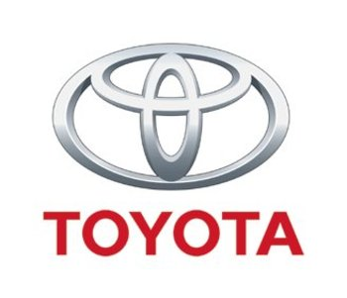
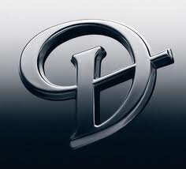




And where major OEMs partner with other entities, competition for space in the vehicle line is also a competitive battle
Daimler – Diversification among motor suppliers
Toyota – Diversification among drivetrains
In addition to its
Globally dominant HEV manufacture
Recently launched Prius V series – including PHEV
JV for EV focused on Chinese market; planned 2012 release
Mercedes ML
450 Hybrid SUV
Joint development of next generation batteries
BMW to supply diesel engines to Toyota
BMW retains hybrid vehicles partnerhsip with Citroen
Joint agreement for production of RAV4 EV using Tesla drivetrain
EM-motive GmbH, 50/50 JV for EV motor development
Vehicles: Smart fortwo ED, other Daimler vehicles
Daimler an equity investor; retains board seat…
Yet Tesla only supplies batteries, chargers for Smart fortwo ED, Daimler A Class (thru 2011)

Slide 8
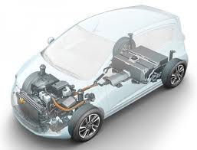
REEs are not a particularly costly EV drivetrain component, but non-REE motors designs often necessitate drive train modifications
Comparison: Vehicle MSRPs
Battery Packs
Packs deeply affect cost & range, and therefore are the focus of massive R&D
Leaf: $35,200
Volt: $40,280
Model S: $49,000
Karma: $102,000
Leaf: $18,000
Volt: $10,000
No significant technical interdependency; except for regen
Electric Motors
Average cost of REEs per EV motor is $50 - $530
$800 - $3,200
Technically interdependent; switching motors requires revisions to power electronics
Power Electronics
New motor designs expected to entail re-engineering battery discharge algorithms; this may be complex depending on motor design.
$700- $1,100
Sources: Gianfranco Pistoia, 2011 (OEM cost estimates for mid-size PHEV components), National Academies, 2010

Slide 9
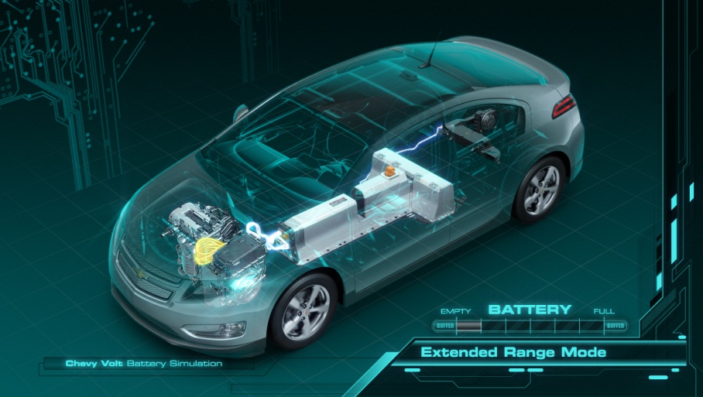
Such modifications, particularly among high-visibility vehicles, may trigger costly and extended development processes
Representative steps to launch a new drivetrain: 4 to 5 year process
Recent Volt fires illustrate high stakes nature of new technology releases
NHTSA: Volt battery a fire risk
Design
Design Validation
Production
Production Validation
Manufacturing
Objective: Quality control
Volt drivetrain developed relatively quickly: about 4 years
NHTSA, Nov. 25: Chevy Volt under formal investigation due to risk of fires in batteries (circled above)
GM Forced to provide free loaners, offer buy-backs
Bigger concern: buyer perception of EVs as safe, reliable
Manufacturing Validation
Regulatory Compliance
Safety
Emissions
Performance Testing
E.g. pikes peak, cobblestones, extreme temps
✓
PRODUCT LAUNCH
Source: OEM interviews

Slide 10
Thus, non-REE components are likely to be secondary to an overall emphasis on step-change enhancements to motors
Performance measure
State of existing technology
Overview
Perm. Mag.
Induction
FOA 4 Targets
Torque and Power
Torque is a measure of the motor’s ability to do work, measured in Newton-meters (Nm)
Power is the motor’s rate of doing work, measured in horsepower or kW
30-100 kW
150-370 Nm
27 - 136 hp
150-215 kW
220-400 Nm
268 - 288 hp
100kW continuous
200kW peak
Weight / Size
Motor size is an issue due to tight engine compartments and cooling requirements
Hybrids are most constrained due to gas engines and generators
100 – 130 lbs
70 – 115 lbs
*Requires cooling and controls that add weight
>1.9 kW/kg
REE content
Mass-produced EV’s use PMMs reliant on REEs, measured as % of magnet weight
Niche EVs (e.g., Tesla) use induction, but OEMs & Tier 1 suppliers investing in development
Dy – 5-6% of mag. weight
ND – 31% of mag.weight
Do not rely on REE
<0.33g/kW
Efficiency
A measure of the motor’s ability to transfer electric power to motion
86% (mean)
88% (Tesla)
>95%
FOA 4 also specifies a cost of <$3/kW

Slide 11
Start-ups and Tier 1 suppliers have arguably catalyzed the EV market, but evolution of the market suggests a formidable role for OEMs
Strategy
Existing EV example
Comments
Start-up
Leverage a technologically disruptive drivetrain into a new and differentiated marque; opportunistic collaboration with OEMs
Tesla Roadster and Model S; cooperative agreement with Toyota for RAV4 EV
Quantum technologies Q-drive for Fisker Karma; F-Drive for Ford
Model is challenged by capital requirements, length of product development cycles
However, substantial OEM executive talent, investor interest is available
Key issue: attain prod. Volume sufficient to ammoritize development costs
Tier 1 supplier
Use existing assets – relationships with OEMs, in-house talent, production facilities, etc .- to develop new product line.
Bosch JV with Daimler for electric motor production
Hitachi agreement to develop Chevy Volt motor
Success requires a dominant position in the market (e.g. Hitachi leadership in magnets)
Subject to rapidly changing competitive dynamics (e.g. Remy loss of Volt contract)
OEM
Acquire and / or develop in-house electric drive train capability
Honda in-house development of electric motors, starting in ‘90s
GM partnership with Hitachi to develop PHEV motors
Nissan in-house production of Leaf drive train
Trend is toward diminished reliance on outsourced motor to cut costs, differntiate
Appear to be assuming dominant market position
Mixed innovation record: GM pioneered EV1 , Toyota launched Prius, but current emphasis on EVs appears inspired by start-ups

Slide 12
FOA 4 Technical Requirements - Vehicles
 | Category Value (Units)
1.1.1 | SCALABLE TO POWER, CONTINUOUS (PEAK POWER FOR 18 SEC DURATION):
1.1.2 | SPECIFIC POWER (PEAK):
1.1.3 | COST (MOTOR)
1.1.4 | RARE EARTH CONTENT
1.2.1 | Efficiency (At Rated RPM)
I
PM
30 – 100 kW
100kW (200kW)
150 - 215 kW
0.8- 1.5
>1.9 kW/kg
<$7/kW (VTP)
<$3/kW
6.5 - 9.5
<0.33g/kW
10g/1kw
>93% (VTP)
86% - 88%
>95%
ARPA-E Target
VTP Target (2015)
I Induction Motor
PM Permanent Magnets
* Note: Figures reflect values reported by manufacturers for a wide variety of drivetrains and as such represent a general guide as to the performance of motors currently available. For example, induction motor statistics are from Tesla, whereas PM motors represent a wide range of hybrid options which are designed to meet a different range of cost and performance parameters.

